Slide 1
SPA/SPAC Updates 2cd Quarter 2018
January 25, 2018
2:30 – 4:00 pm

Slide 2
SPA’s Agenda
Personnel changes
NIH updates (Forms E, HSCT, sub awards)
Workspace & ASSIST
Reminders

Slide 3
SPA Personnel Changes
T’Nesha (Odessa) Neale
Contract & Grant Associate
IMPACT Studies (working directly with Dennis)

Slide 4
NIH Updates
Updated NIH Policy Statement 10/2017
Significant changes have been released in Notices
Forms-E required NOW required! See NOT-OD-17-062
Parent Announcements reissued with new FOA #’s
Choose the correct FOA!

Slide 5
Forms E Changes
Updated the expiration date on several forms to 03/31/2020
See Notice NOT-OD-17-062 for specific information
The PHS Human Subjects and Clinical Trials Information Form (HSCT) PDF is now required for ALL NIH Proposals
Proposals with clinical trials have specific FOA

Slide 6
PHS HSCT Form (Human Subjects Clinical Trial Form)
Open with Adobe Reader ONLY!
Work with the PI to complete the HSCT Form
Link the FOA to the proposal after attaching the HSCT form
If you need to replace the form, re-link the FOA
See SPA website for instructions http://www.umaryland.edu/kualicoeus/user-resources-and-help/nih-forms-e-instructions/

Slide 7
HSCT Form
If there are human subjects, the HSCT must include:
1 or more full study records, OR
1 or more delayed onset study records, OR
A combination of full and delayed onset study records
See definition for Delayed Onset (SPA or NIH website)
Required form fields vary based on a number of factors, including:
Whether study is delayed onset
Announcement-specific instructions
Human subject exemptions
Whether study involves a clinical trial
Notes:
Human subjects research is anticipated within the period of award but definite plans for this involvement cannot be described in the application.

Slide 8
Subaward Budget Forms
4 new versions
KC proposal must be linked to FOA
S2S form must match Subaward Budget form
Send the correct forms to your subs

Slide 10
Workspace & ASSIST
Workspace Training and Tutorial Videos
https://www.youtube.com/user/GrantsGovUS
The use of ASSIST or Workspace must be approved by Dennis Paffrath
Must have a Grants.gov account and be affiliated with UMB
Use of either is approved case by case

Slide 11
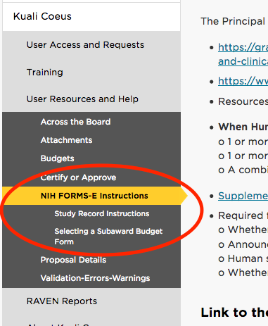
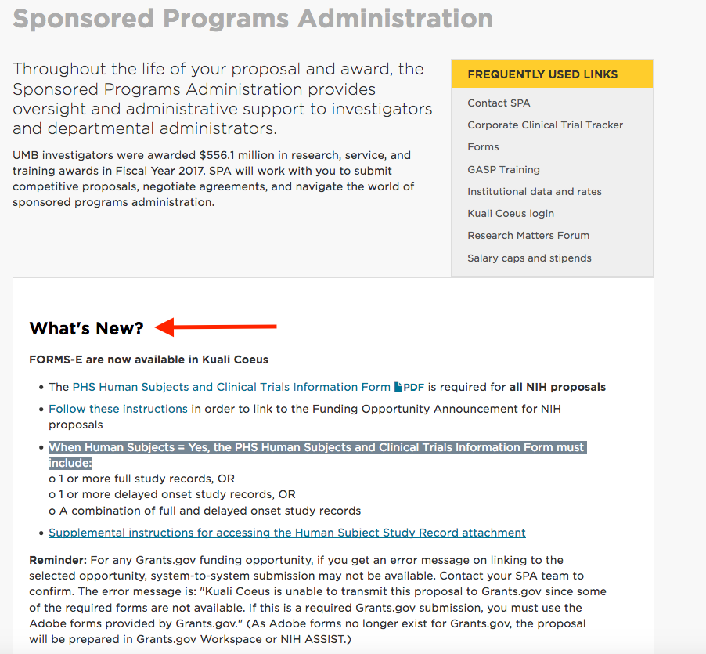
SPA Website

Slide 12
Proposal Reminders
Proposal Review Procedure Effective 7/2017
Do NOT change the Job Codes in KC!
Complete tabs
Proposals marked Final will be submitted
NOT-OD-16-129 Appendix Materials (rel. 08/2016)
Applications will be rejected if unapproved materials are included in the Appendix

Slide 13
Reminders
Please, please use the team emails when communicating with SPA, unless an action has been triaged and you know who the SPA person that is working on that action.
Ask your general questions at Research Matters http://researchmatters.umaryland.edu
If you change the deadline date, please update your team or the person working on your proposal immediately!
Please give SPA adequate time to review your proposal.
SPA will only bypass on the deadline day.

Slide 14
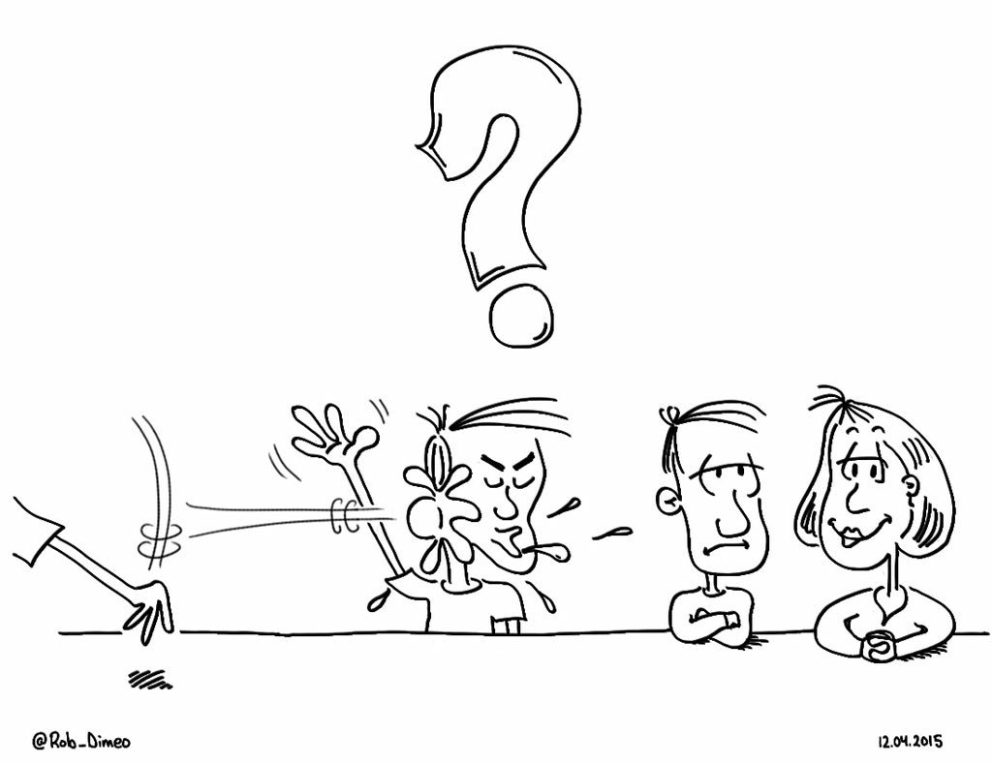
Questions?

Slide 15
SPAC Updates 2st Quarter 2018
January 25, 2018
2:30 – 4 pm
Pharmacy Hall: N103 Lecture Hall

Slide 16
Today’s Agenda
Cost Update
Staffing Update
Government Shutdown
Contract Reporting
DHMH Form Returns
Annual FFR change
Project Set Up Change
Reminders
Departing PI Award Disposition Notification

Slide 17
Cost Updates 3rd Quarter 2018
January 25, 2018
2 – 4 pm
Pharmacy Hall: N203 Lecture Hall

Slide 18
COST Reminders
We are still working on an extension for the FA rate proposal with the Federal Government
Fringe Rate Proposal almost done
The NSF survey is being submitted with College Park
The new effort reporting period 123117 is available in ERS. Please certify all outstanding effort forms

Slide 19
Questions?

Slide 20
SPAC Staffing Updates
Krista Salsberg – Sr. Manager Promotion
Christopher Hook - Accountant 1
Marcelle Finyom Djiogo (Rhoda) – Accountant 1
OPEN POSITIONS
Manager, Team White
Manager, Central Team
Accountant 1, Cost Team

Slide 21
SPAC Staffing Updates
COST | CENTRAL
Beryl Gwan Sr. Manager Binita Shah Cost Accountant Amy Sallese Pt Cost Accountant Vacant Accountant 1 | VACANT Manger Mary Miller Accountant Colin Fleming Accountant 1 Neda Karimi Accountant 1 Marcelle Finyom Accountant 1 Neli Georgieva Financial Acct Larcell Pannell Financial Acct

Slide 22
SPAC Staffing Updates
KRISTA SALSBERG, SENIOR MANAGER
TEAM RED | TEAM WHITE
Ron Hill
Financial Accountant Analyst
Brenda Hester
Accountant

Slide 23
SPAC Staffing Updates
WHITE TEAM | RED TEAM
Vacant Manager Krissy Long Financial Accountant Analyst Tammira Barnes Financial Accountant Analyst Claude Street Accountant 1 | Cheryl Williams-Smith Manager Shernett Wynter Financial Accountant Analyst David Addy Financial Accountant Analyst AJ Singh Financial Accountant Analyst Jean Indrova Gonzales Accountant 1
Chris Hook Accountant 1

Slide 24
Government Shutdown
In the case of a contract or grant that has been previously awarded (and thus for which available funds were obligated), can Federal employees be excepted from furlough in order to make timely payments to the contractor or grantee in accordance with the contract or grant?

Slide 25
Government Shutdown Payment
During a lapse in appropriations, the activity of making contract and grant payments on a timely basis does not, by itself, qualify as one of the limited circumstances for which obligations can be incurred under the Antideficiency Act (as outlined in l.A.-B., above). In this regard, the fact that the government would incur interest penalties under the Prompt Payment Act or other law due to the delay in payment caused by a funding lapse does not provide a legal justification under the Antideficiency Act for an agency to continue to make payments during a funding lapse.

Slide 26
Government Shutdown Payment
Grants on the LOC, do not require someone on the other side. If the funds are available, we SHOULD be able to draw as long as they are not expired funds
More information on the Government Shutdown
https://www.whitehouse.gov/wp-content/uploads/2017/11/m-18-05-Final.pdf

Slide 27
Contract Reporting
Required to report hours to our prime
We are not an hourly reporter – we are a effort reporting institution
Those with Federal pass-through contract should be capturing hours on your invoice
Those of you with subs on your federal contracts should have your subs report hours on each invoice

Slide 28
STATE/DHMH INVOICING
To comply with payroll and nonpayroll support https://health.maryland.gov/pages/sf_dcpf.aspx
The payroll report requires signature by the PI and a designated management staff in SPAC
This support must accompany the invoice
Currently this only applies to Interagency Agreements – with another State Agency – for either procurement of a good/service or hiring an employee

Slide 29
STATE/DHMH INVOICING
Timing
January - July
April - October
Turnaround immediately
If not sent with the invoice RISK
Not paid
Not release new funding

Slide 30
ANNUAL FFR CHANGE
Reporting is always for the date of expiration
Snapshot of what is happening on that date of expiration
We will be putting the expense stated in the financial system at that date of expiration
This goes in line 10E of the FFR
Any spending after this goes into the Unliquidated line 10F

Slide 31
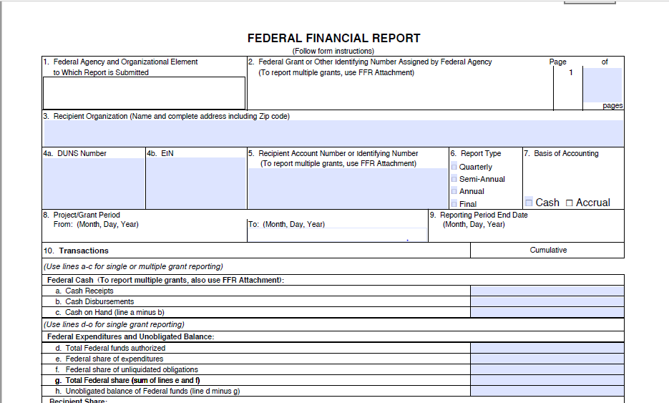

Slide 32
ANNUAL FFR CHANGE
This will mainly be for NIH
For all other HHS Agencys we need to do special reporting based on our draws
This is because they account for their funds differently
Defer to your SPAC Team Analyst for the appropriate treatment

Slide 33
Project Setup Change
For all Federal Awards that have automatic carryover, whether they are competitive or not
Will only have 1 project with an award date for the years expected to fund
Just like the SNAP awards
Your Project end date will change each year you are funded

Slide 34
REMINDERS

Slide 35
Departing PI Award Disposition Notification
This form is to notify SPA and SPAC that a named Principal Investigator (PI) for a sponsored award leaves the University of Maryland Baltimore (UMB)
Allows us to start the appropriate paperwork to initiate either a transfer the award to another institution, to another investigator, or terminate.
Please allow 5 business days for the team to analyze the PI accounts and draft required documentation.
For more information, refer to Faculty Transfers – Outgoing Policy or the Departing PI Award Disposition Procedure.
http://www.umaryland.edu/spac/sponsored-projects-accounting-and-compliance-spac/departing-pi-award-disposition-notification/

Slide 36
Questions

Slide 37
Final Notes
Both presentations will be available on SPA and SPAC websites
Thanks for joining us today!

